Slide 1
DIFFERENCE BETWEEN ENTREPRENEURS AND MANAGERS
Dr.Rachanaa Datey

Slide 2
Definition of Entrepreneur
The term ‘entrepreneur’ is a French origin which means ‘go between’ or ‘between-takers’. An entrepreneur is a person who creates a new enterprise by assembling inputs (i.e. land, labour and capital) for production purposes. He assumes all risk and uncertainty, in order to achieve profit and growth of the business venture by identifying new opportunities and combining resources for the purpose of capitalizing them. He innovates new ideas and business processes.

Slide 3
They are classified as
an innovative entrepreneur,
imitating entrepreneur,
fabian entrepreneur,
drone entrepreneur.
Further, they can be classified on the basis of business, technology, motivation, area, stages of development, etc.

Slide 4
The characteristics of a successful entrepreneur
RISK TAKER
COMMITMENT AND CONVICTION
CAPACITY TO ANALYZE
INITIATIVE AND INDEPENDENCE
HIGH PERSONAL EFFICIENCY
HIGH NEED FOR ACHIEVEMENT

Slide 5
Definition of Manager
The term ‘manager’ we mean a person who gets the things done through his subordinates, with the aim of accomplishing business objectives efficiently and effectively.
The five primary functions of a manager are
planning,
organising,
directing or motivating,
coordination and
control.

Slide 6
The characteristics of a Manager
The manager is in charge of the particular division, unit or department of the company.
He may directly command to workers, or he may direct the supervisors, who will command workers.
He is the one under whose supervision, his subordinates work and report to him.
Managers can be top level managers, middle-level managers, low-level managers.

Slide 7
The primary difference between managers and entrepreneurs is that entrepreneurs and managers THINK DIFFERENTLY.
THEY THINK DIFFERENTLY

Slide 8
APPROACH
The management preferred causal reasoning sets a tangible goal and then seeks to secure the best possible means/resources to achieve it.
The entrepreneur preferred effectual reasoning evaluates the uniqueness of the means/resources that the entrepreneur can access and then leverages the unfair advantage attached to those means/resources to determine the best possible fit for an as yet to be determined goal.

Slide 9
Entrepreneurs as I think are prepared to take gambles and make big decisions and also to accept the full responsibility for the results, good or bad. Entrepreneurs tend to try their hand at lots of things, are full of ideas and tend to get easily distracted.
Managers in my experience, are more pragmatic, detail orientated and organized in their approach. They tend to be more focused on one goal until completed.

Slide 10
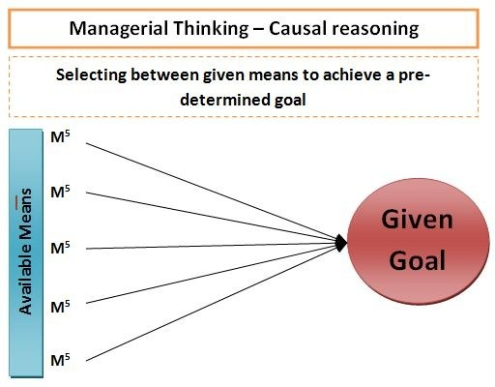
MANAGER

Slide 11
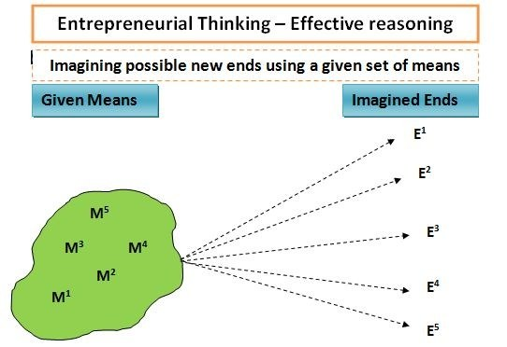
ENTREPRENEUR

Slide 12
Let’s Differtiate
ENTREPRENEUR | MANAGER
A person who creates an enterprise, by taking a financial risk in order to get profit, is called an entrepreneur | An individual who takes the responsibility of controlling and administering the organization is known as a manager.
Entrepreneur is a risk taker | The manager is risk averse.
An entrepreneur focuses on business startup | the main focus of a manager is to manage ongoing operations.

Slide 13
ENTREPRENEUR | MANAGER
Achievements work as a motivation for entrepreneurs | The primary motivation for manager is the power.
An entrepreneur’s approach to the task is informal | The manager’s approach to the task is formal
An entrepreneur is the owner of the enterprise | A manager is just an employee of the company.

Slide 14
ENTREPRENEUR | MANAGER
Profit is the reward for the entrepreneur | A manager gets salary as remuneration for the work performed by him.
An entrepreneur’s decisions are driven by inductive logic, courage, and determination; that is why the decision making is intuitive | The decision making of a manager is calculative, as they are driven by deductive logic, the collection of information and advice.
The major driving force of an entrepreneur is creativity and innovation. | A manager maintains the existing state of affairs.(Most of the times)

Slide 15
CONCLUSION
After reviewing the above points, it is quite clear that entrepreneur and manager are two different persons in an organization. So they cannot be juxtaposed. While managers concerned with managing available resources, entrepreneur focuses on spotting and capitalizing opportunities.
(Participants may have different opinions )

