Slide 1

FINANCIAL MODELS
Dr.Rachanaa Datey

Slide 2
What is Financial Modelling?
A financial model is a tool that allows you to understand the financial implications of your business decisions.
In other words, it helps you have an answer to the question, "If we do this, what will be the result?”.
Financial modeling is the use of accounting, finance, and business measurements to create abstract representations of an organization’s financial situation.

Slide 3
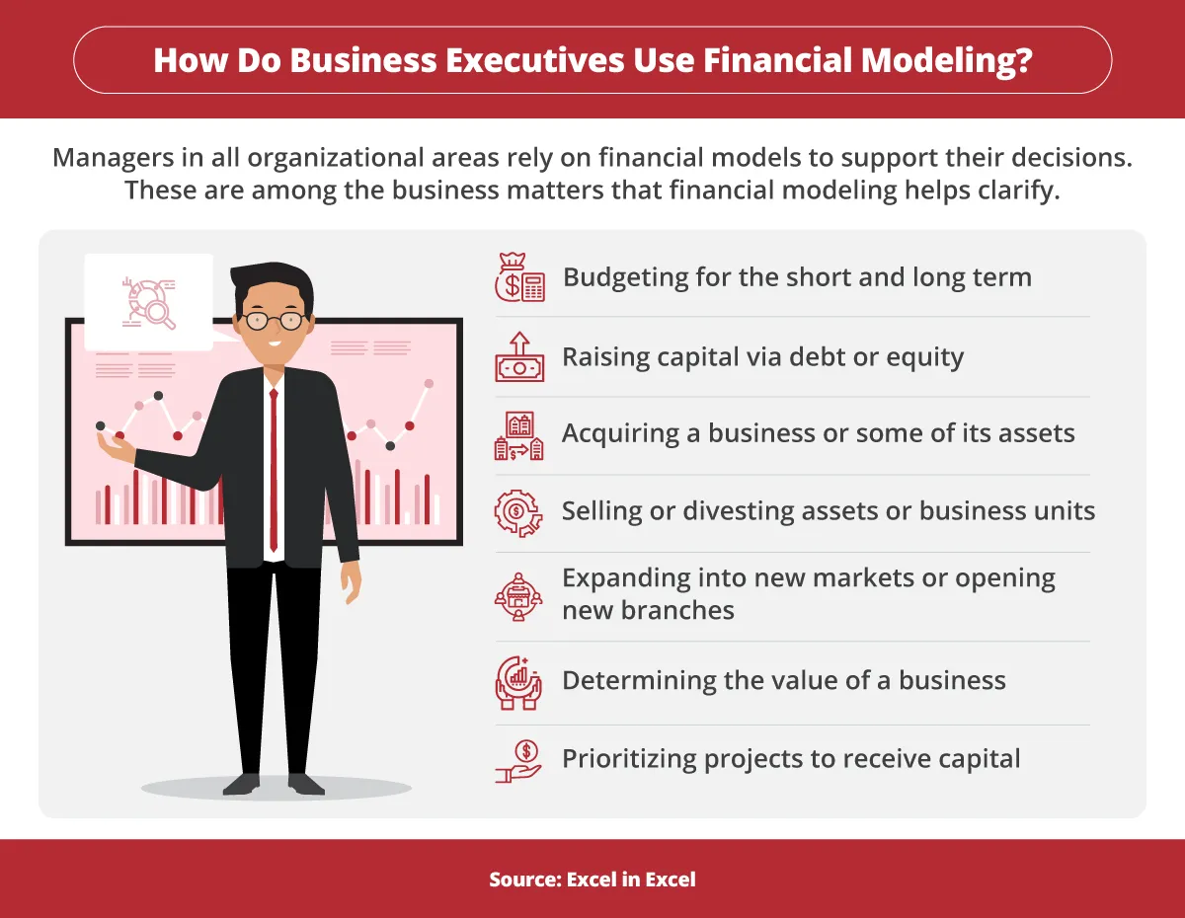

Slide 4
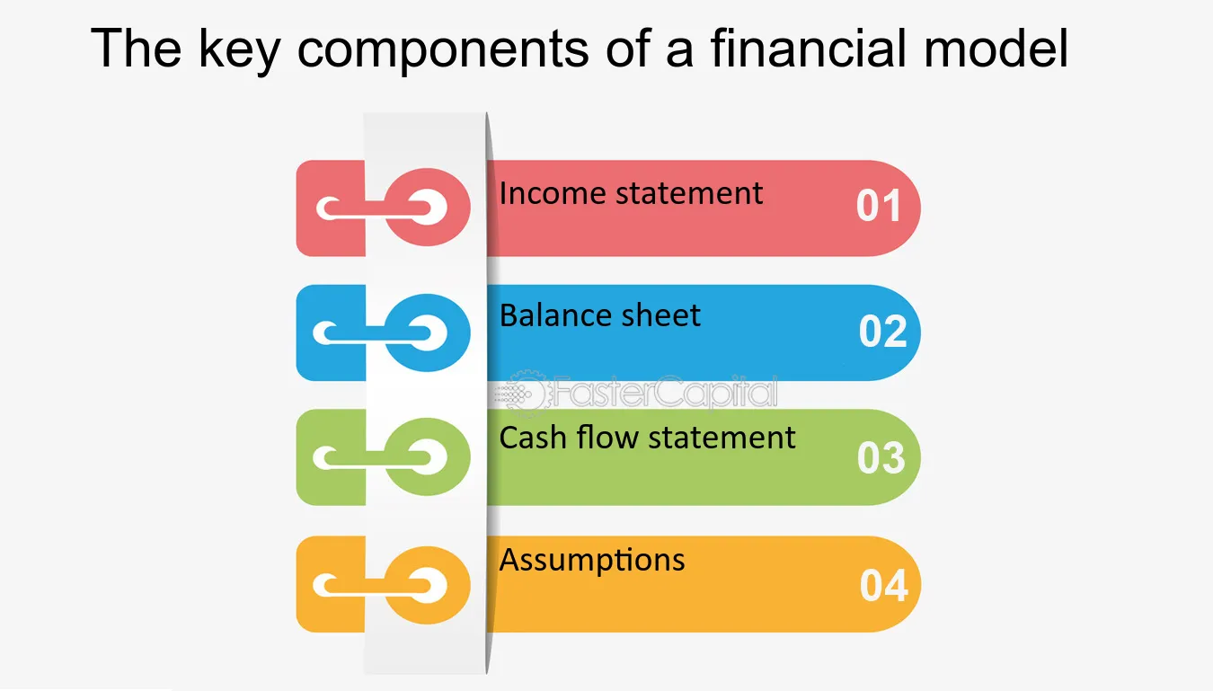

Slide 5
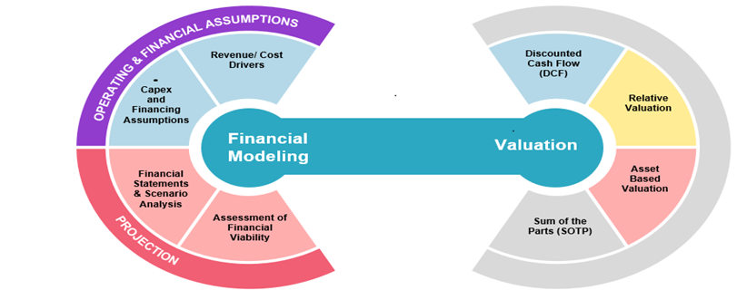

Slide 6
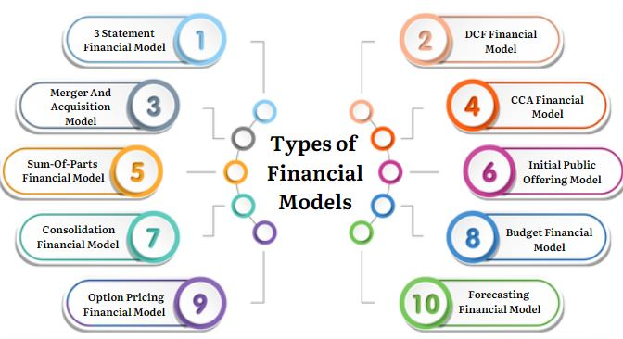

Slide 7
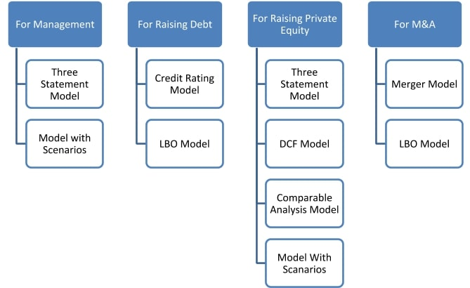

Slide 8
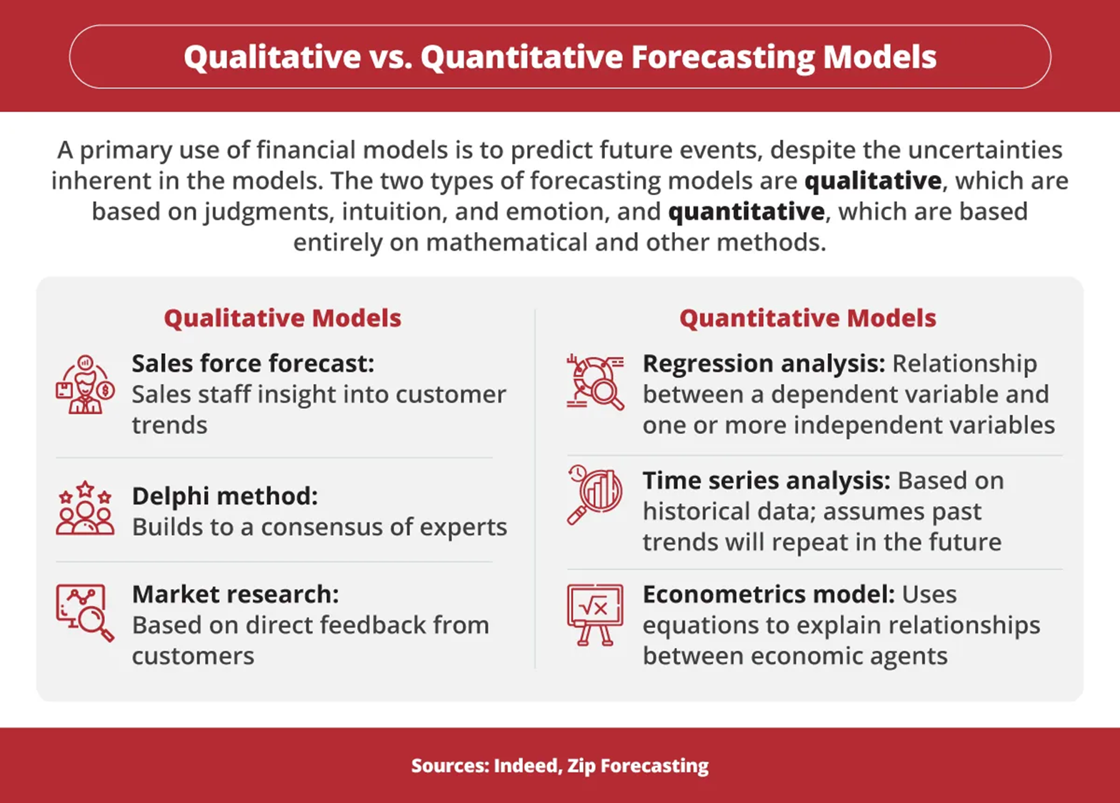

Slide 9
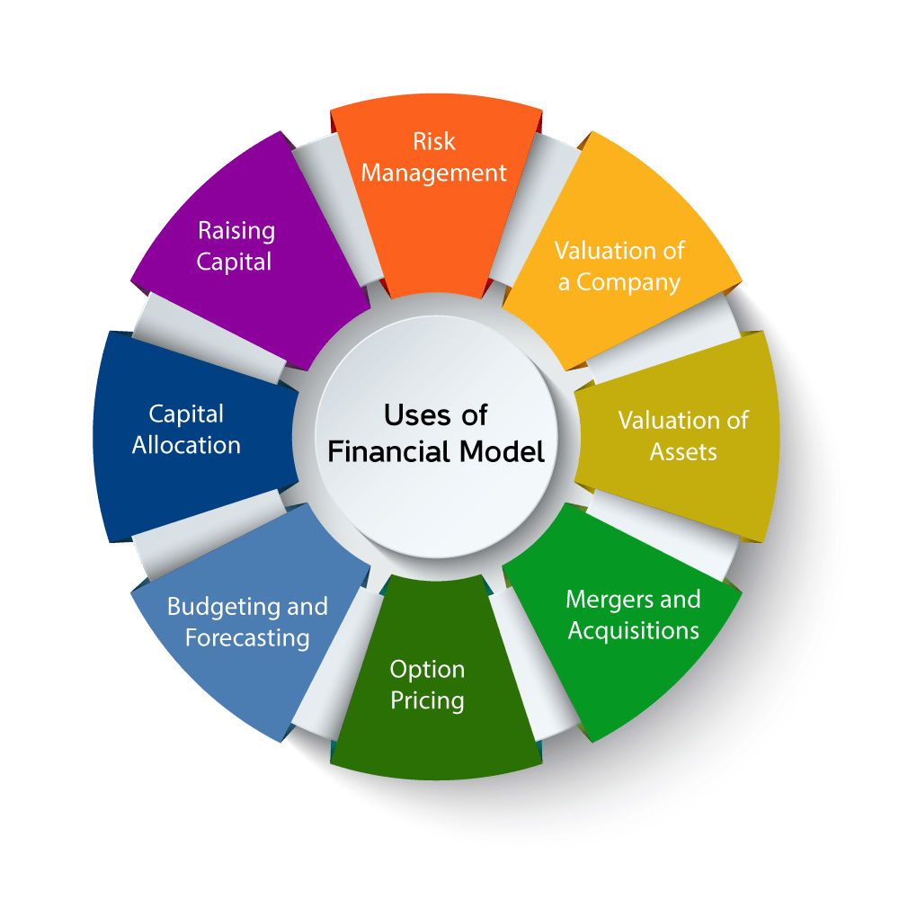

Slide 10
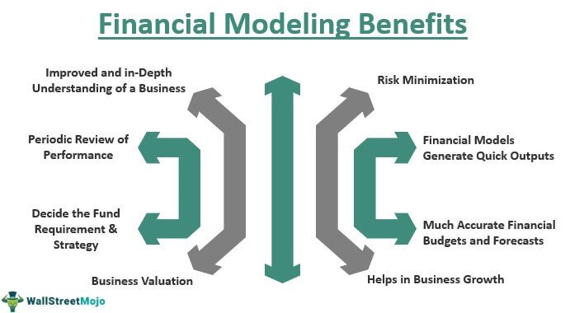

Slide 11
Who Uses Financial Models?
Executives in all parts of an organization rely on financial models in their day-to-day work.
Financial analysts typically rely on complex spreadsheets designed to serve a specific purpose, such as sales forecasts, budget allocations, and asset appraisals.
Financial planners address the long-term financial concerns of families and individuals by applying models for retirement income estimation, cash flow projections, net worth calculations, and legacy goals.

Slide 12
Contd..
Chief financial officers are responsible for updating the organization’s business model to ensure it will have the resources it requires to achieve its objectives. They use financial models to identify impediments to growth, emerging risks, and new opportunities.
Business managers use financial models to prepare budgets and make strategic plans. By modifying variables in the models, managers can forecast the business’s performance under many different scenarios.

Slide 13
Contd..
Project managers apply financial models while planning and implementing projects to ensure sufficient cash flow, manage project resources and schedules, and simulate various project scenarios. Many project managers use the modeling features built into the Program Evaluation and Review Technique (PERT).
Investment bankers and portfolio managers depend on financial models to determine the fair or intrinsic value of a company’s stock to make investment decisions based on those assessments, and to identify merger and acquisition candidates.

Slide 14
Contd..
Risk managers have expanded their use of financial models to include risks associated with the networks that partners and other third parties in the global supply chain use. Financial models allow firms to measure risk trends and respond faster to threats and to promote accountability for risk mitigation.
Accountants can leverage their use of financial models to broaden their role in organizations beyond bookkeeping to include data analysis and financial decision support.

Slide 15
Best Practices in Financial Modelling
Objective: The financial model should always have a concrete objective to achieve. Hence, it is essential to identify and clearly define such targets. Apart from this, you must identify data sources, key stakeholders, and financial assumptions that will play a critical role in financial modelling.
Standardised Templates: These ensure consistency and accuracy in data collection, segregation, and analysis. Templates can be customized as per objectives, but fundamental concepts should not be eliminated.

Slide 16
Contd…
Data Validation: Data collected from different sources should be cross-checked and authenticated to eliminate duplication and error in datasets. A separate team consisting of specialists for data validation will be beneficial as the volume of data can be very high and technical.
Assumptions: The next thing is to take care of the assumptions and ensure they are consistent with past trends. While determining assumptions, you can also conduct a sensitivity test to understand changes occurring in output.

Slide 17
Contd…
Formulas: Using proper formulas and statistical tools is vital, as the entire output is based on your formula. Check the formula twice before using it, and ensure you put the correct data in all variables.
Validation: This entails comparing the output with the actual results. If there is a divergence between the two, conduct a thorough analysis of the financial modelling system and fix the errors and biases.

Slide 18
Challenges of Financial Modelling in Decision-making Process
Time Consuming: One of the biggest challenges of financial modelling is its time-consuming process. A financial model consists of several stages, with complex tasks at each stage. It costs the company a lot of resources and time and is not feasible for small companies.

Slide 19
Contd..
Inaccurate: There have been many instances worldwide where financial modelling has proven incorrect. One of the major examples of its failure is the 2008 subprime lending crisis. Predicting different variables, like interest rates, taxation policies, consumer trends, etc., is complicated. As a business, you would be doomed if you solely rely on financial modelling while making crucial decisions.

Slide 20
Contd..
Non-consideration of Soft Factors: A business is not only about numbers and statements. Soft factors like synergies, consumer loyalty, and company culture are important but should be considered when doing financial modelling.

Slide 21

HOW TO BUILD FINANCIAL MODELS

Slide 22
Step 1: Gather Historical Data
Financial models require at least three years of a company’s financial data. The less historical the data available to the model, the less accurate the model results will be.
By reverse-engineering the data, analysts can calculate revenue growth rate, gross margins, and variable and fixed costs. The results are used to complete assumptions for the forecast period.

Slide 23
Step 2: Calculate Ratios and Metrics
The historical data also serves as the foundation for determining historical ratios and metrics, including growth margins and rates, inventory changes, and asset turnover ratios.
Four types of ratios that support business and financial decisions are profitability ratios; liquidity ratios; solvency ratios; and valuation ratios, which are also called multiples.
To avoid cherry-picking ratios that present a company’s finances in the best light, ratios are typically used in combination to provide a comprehensive view from many different angles.

Slide 24
Step 3: Make Informed Assumptions
Historical data, ratios, and metrics serve as the basis for formulating assumptions about a company’s financial future.
These assumptions help analysts calculate future growth margins and growth rates, potential asset turnover, and possible changes in inventory.
Among the assumptions created are those relating to revenues and expenses, as well as working days in a year and seasonal variance.

Slide 25
Step 4: Create a Forecast
Combining historical data, ratios, metrics, and assumptions leads to the formulation of a specific forecast of a company’s future cash flow, income, and balance sheets.
The forecasts usually attempt to answer a single question, such as the financial feasibility of an acquisition or a capital expense, or whether to shut down or outsource certain operations.
They’re also used to gauge the level of risk involved in a specific transaction.

Slide 26
Step 5: Determine a Value for the Company or Asset
Once the financial forecast is complete, various models can be applied to find the value of a firm, a division, or an asset, typically using the DCF method or the present value of free cash flows.
The DCF model assumes the company being analyzed will continue to sell its products with no drop in demand, thus guaranteeing a steady cash flow.
The present value of free cash flows assumes the firm’s management will spend its capital in ways that preserve its cash flow and that the value of the present cash flows exceeds the company’s stock value.

Slide 27
Step 6: Review and Compare Various Resulting Scenarios
The more scenarios the model constructs, the clearer the picture of the future that the financial model generates.
It may seem counterintuitive that a model that creates a range of possible future outcomes is considered more accurate than a model that generates a single forecast, but scenario modeling allows analysts to compare many potential eventualities rather than only the one the model identifies as most likely or the best case.

Slide 28
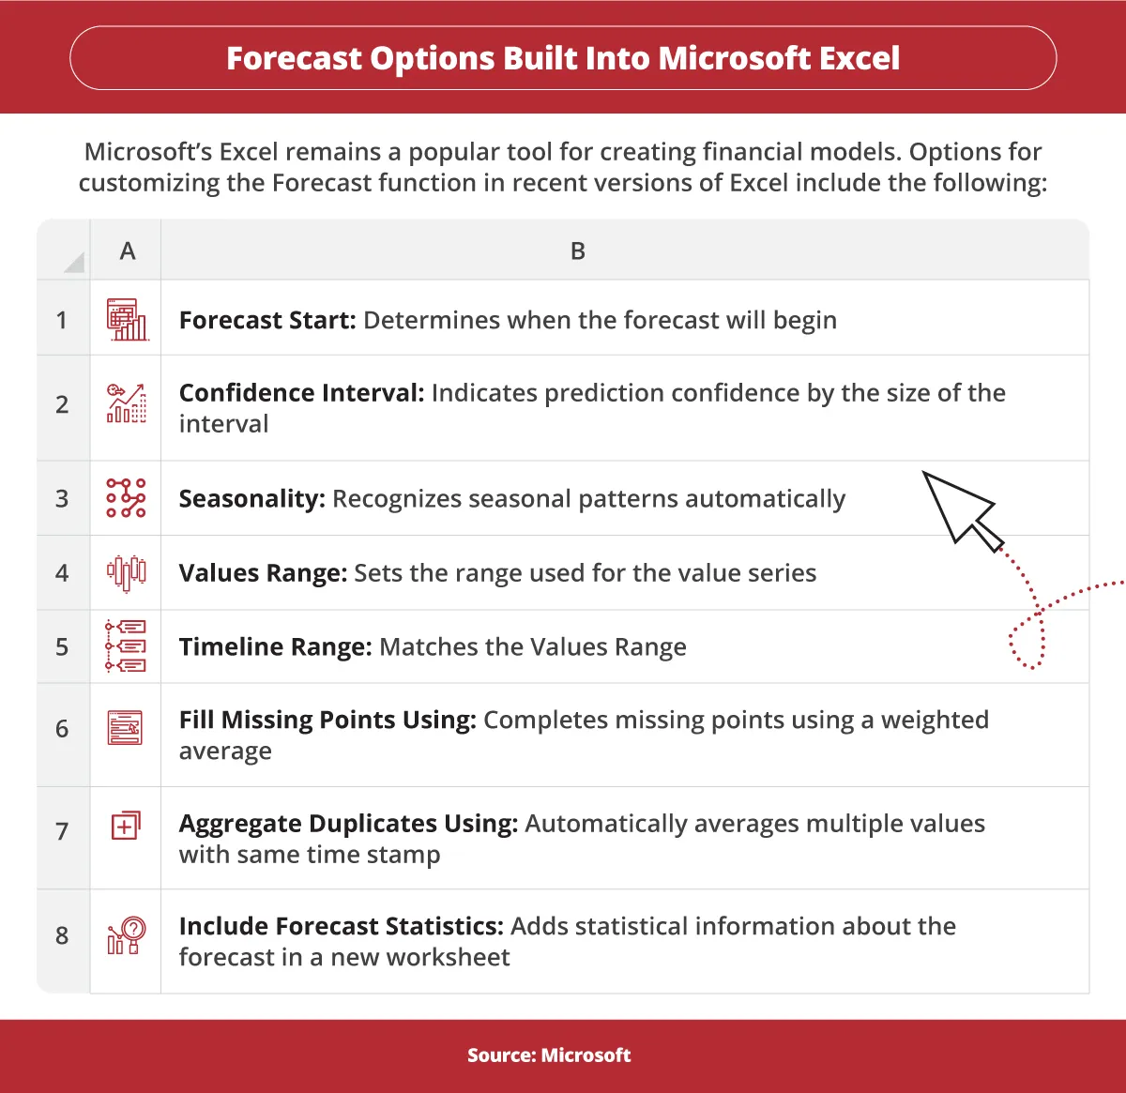

Slide 29

QUESTIONS ??

Slide 30
FAQ
1. What software is commonly used for financial modelling?
Cube, OracleBI and Jirav are some of the most common and widely used software in financial modelling.
2.Are there any regulatory requirements for financial modelling in certain industries?
There are no regulatory requirements for financial modelling (till date).

