Slide 1
RESOURCE BASED THEORY
Dr.Rachanaa Datey

Slide 2
WHAT IS RESOURCE BASED THEORY (RBT)
Early work of RBT acknowledges that eship is an intricate part of Resource based frame work.(Conner1991,Rumelt1987)
While RBT become a dominent paradigm for strategic management Research (Peteral 1993, Grant1991)the interface between RBT and ESHIP has been amounted to little more than providing Research Setting for empirial work.

Slide 3
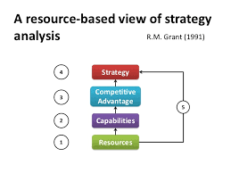
RBT –R.M.GRANT (1991)

Slide 4


Slide 5
EVERY FIRM IS UNIQUE
It is a firm’s unique bundle of resources that is different from competitor firm’s resources.
These unique resources are potentially valuable and contribute to a firm’s competitive advantage

Slide 6
CASH THE OPPORTUNITIES
Entrepreneual opportunities exist primarily because different agents have different beliefs about relative value of resources when they are converted from input to output.

Slide 7
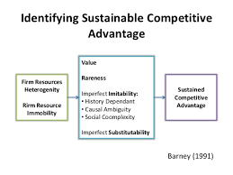

Slide 8
COMMON ATTRIBUTE
RBT and ET have one common Attribute i.e. HETEROGENEITY.
RB Logic has tended to focus on HETEROGENEITY of resources
While
ET has tended to focus on HETEROGENEITY of beliefs about the value of resources
(these Resources may manifest themselves in many different ways)

Slide 9
MOST IMPORTANT
RBT suggests and assumes that at least some resources bundles and capabilities underlying production are heterogeneous across firms

Slide 10
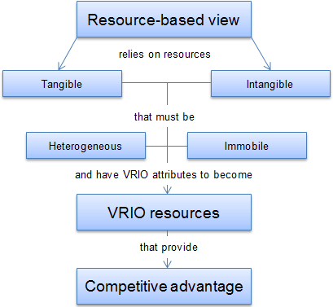

Slide 11
VRIO
VRIO is an initialism for the four question framework asked about a resource or capability to determine its competitive potential: the question of Value, the question of Rarity, the question of Imitability (Ease/Difficulty to Imitate), and the question of Organization (ability to exploit the resource or capability).
Is it valuable
Is it Rare
Is it difficult to Imitate
Is the firm properly organised

Slide 12
VRIO framework is the tool used to analyze firm’s internal resources and capabilities to find out if they can be a source of sustained competitive advantage.

Slide 13
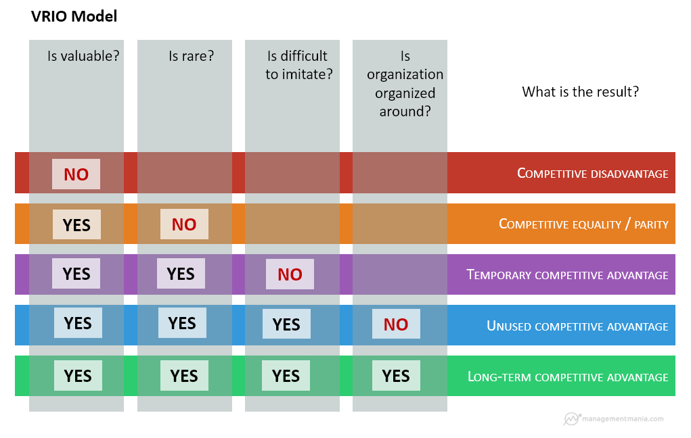
VRIO MODEL

Slide 14
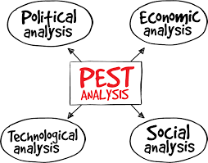
PEST ANALYSIS

