Slide 1
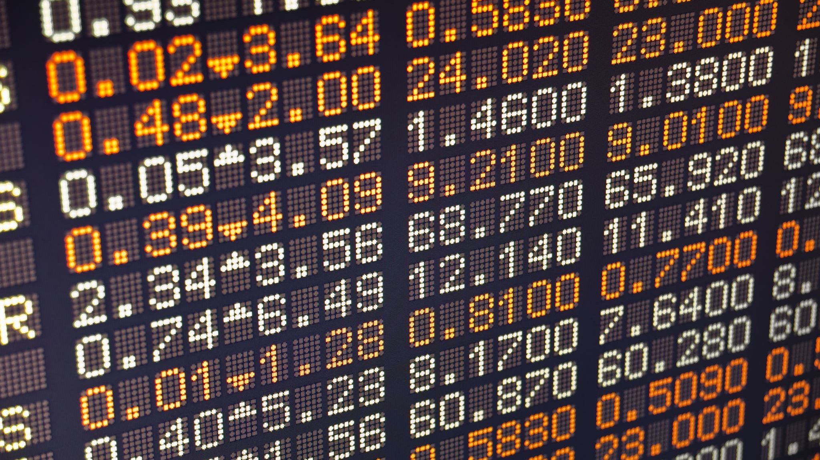
Foreign Exchange Markets
Dr.Rachanaa Datey
Founder Director
QUEST EDUSTATION Trainings and Learning Solutions

Slide 2

Foreign Exchange Markets
Foreign exchange markets determine the exchange rates for currencies worldwide.
The foreign exchange market is also called forex, FX, or even the currency market.

Slide 3
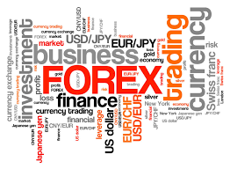
Foreign Exchange Markets include ….
Banks,
Forex Dealers,
Commercial Companies,
Central Banks,
Investment Management Firms,
Hedge Funds,
Retail Forex Dealers,
Investors.

Slide 4

Currency market in India
As per the RBI, OTC and spot markets are dominant in the Indian currency market .
Currency futures are traded on exchanges such as NSE, BSE, and MCX-SX.
The volume of transactions done through Foreign Exchange Companies in India amounts to about US$2 billion per day.

Slide 5
Trends in the forex market
The USD is the most traded currency in the world (being a part of over 85% of trades), which allows it to act as an unofficial reserve currency among other countries.
The Euro and Yen come as distant second and third.

Slide 6
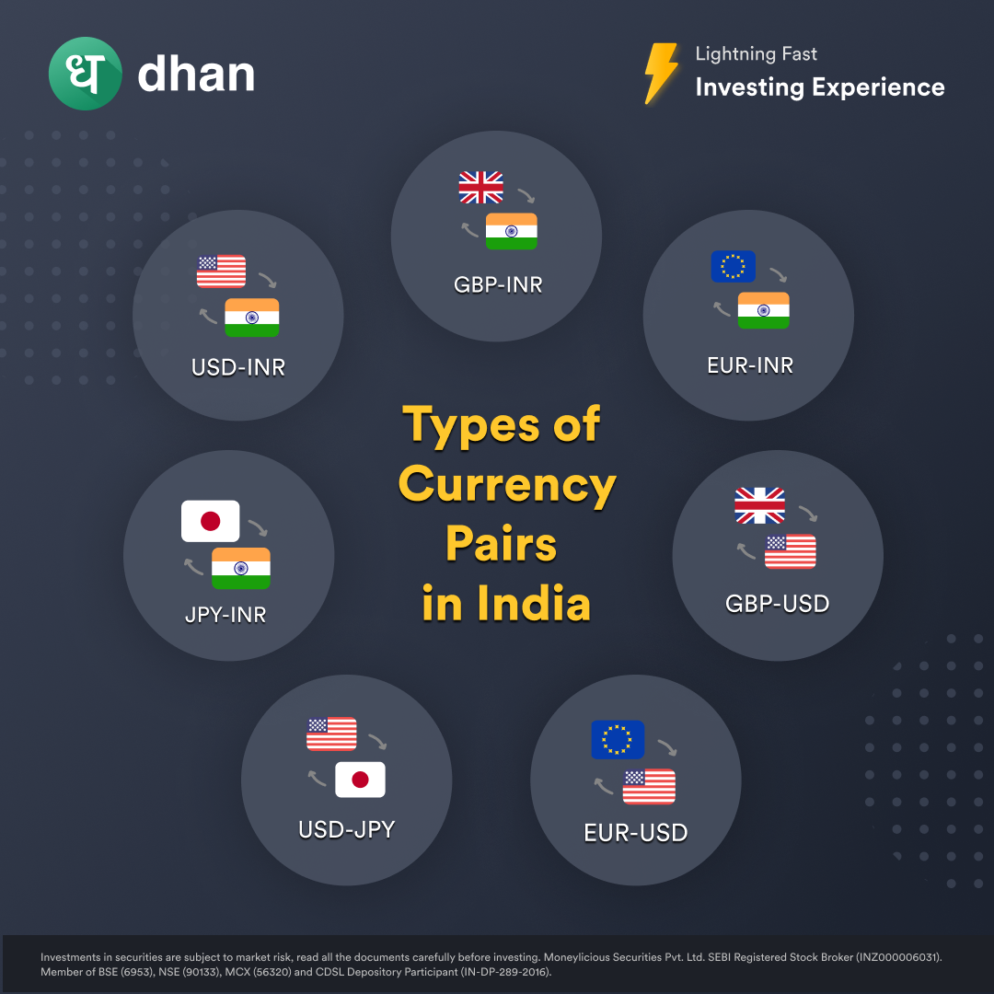
What is the size of the forex market in India?
The India foreign exchange market was valued at USD 30.7 Billion in 2024.

Slide 7
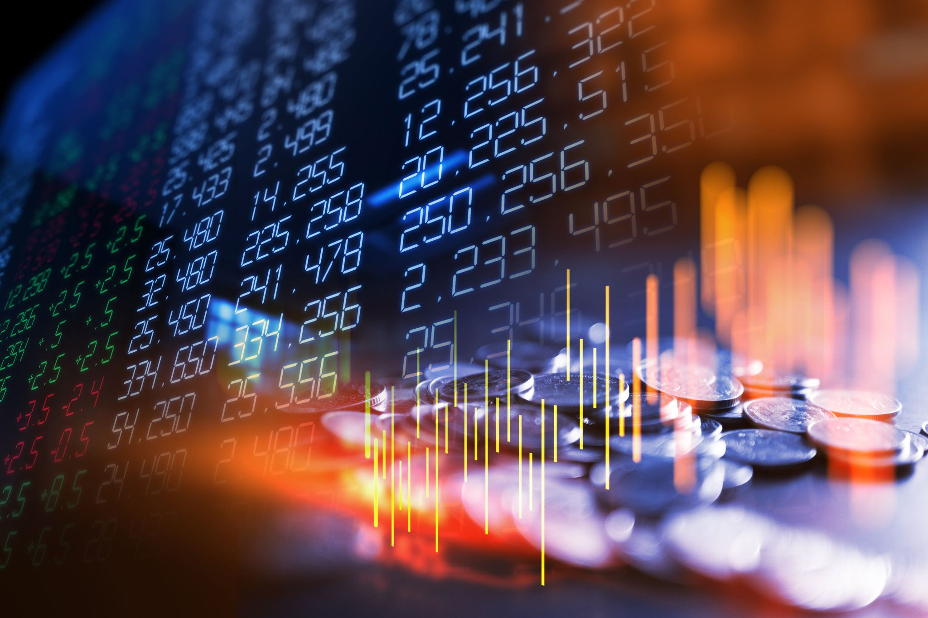
Features of Foreign Exchange Markets
High Liquidity- It’s like having the freedom to trade your money for another country’s money at any time.
Market Transparency- It helps them keep an eye on how currency prices change in real-time.
Dynamic Market- It’s a market that’s always changing.
Operates 24 Hours- This market is open 24 hours a day. Traders can trade at any time.

Slide 8
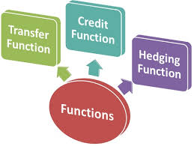
Functions and Roles of Foreign Exchange Markets

Slide 9

Transfer Function
The foreign exchange market’s basic function is to transfer funds or foreign currencies between countries to settle their payments. The market converts one currency into another.

Slide 10

Credit Function
The foreign exchange market also provides short-term loans to people or businesses who need to buy things from other countries. This helps the smooth flow of goods and services across borders. Buyers can use these loans to pay for stuff from other countries.

Slide 11
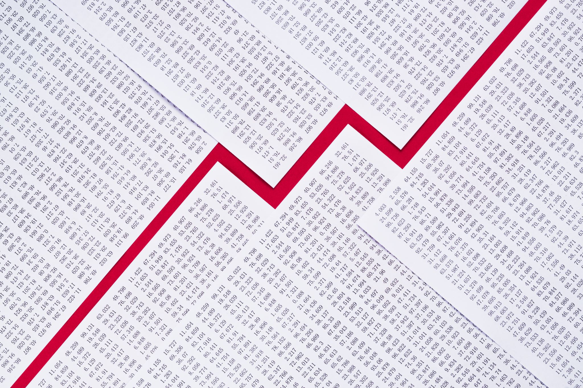
Hedging Function
A forex market hedges foreign exchange risks. It is common for parties in foreign exchange to fear fluctuations in exchange rates, which are the price of one currency compared to another currency. Depending on the circumstances, the party may gain or lose money.

Slide 12
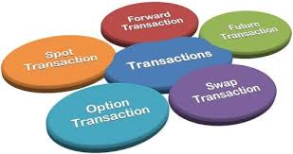
Types of Foreign Exchange Markets and Their Roles

Slide 13
Spot Forex Market
The fastest currency transactions occur in this market.
This forex market provides immediate payment to buyers and sellers based on the current exchange rate.
Nearly one-third of all currency exchange takes place on the spot market, with trades usually settling in one or two days

Slide 14
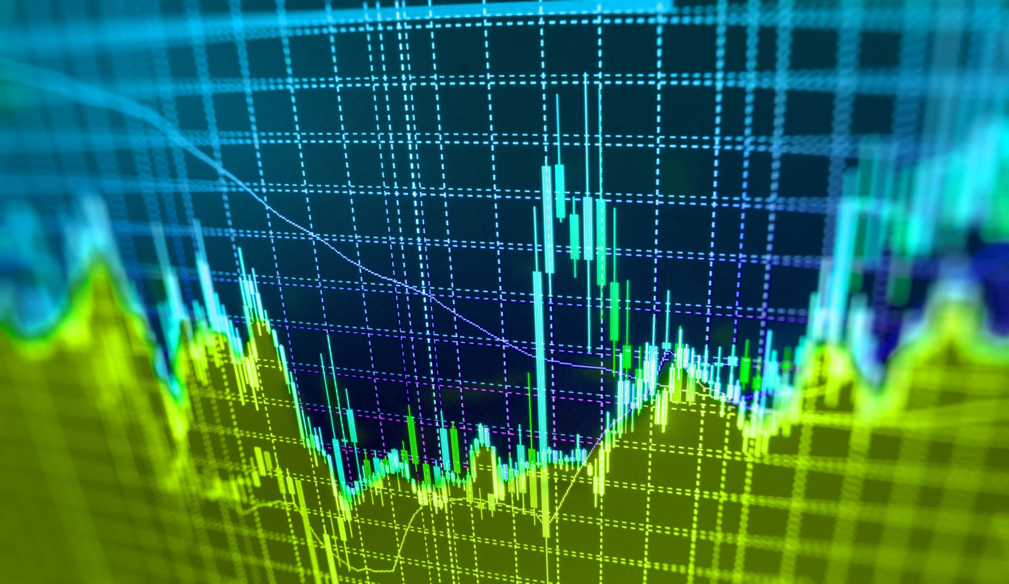
Forward Forex Market
In the forward market, two parties agree to exchange currencies at a set price on a future date.
They don’t actually swap money right away, just the value of the currency.
This is often used to protect against future price changes.

Slide 15
Futures Forex Market
Similar to the forward market, it’s regulated and happens on an official exchange. This reduces the risk.
People use futures contracts for hedging, too.

Slide 16
Option Market
An option is like a contract that gives an investor the choice (but not the obligation) to buy or sell something like a stock, ETF, or index at a specific price over a certain period.
People trade options in this market.

Slide 17

Swap Market
The swap contract involves two parties exchanging cash flows or liabilities arising from two different financial instruments.
Typically, swaps involve these cash flows based on a principal amount.

Slide 18
Benefits of Participating in Foreign Exchange Markets
Unlike other markets, there are fewer rules, so investors aren’t held to the same strict standards and regulations.
Forex markets are not regulated by clearing houses or central bodies.
Investors will not have to pay traditional fees or commissions like they would on another platform.

Slide 19
Contd..
Traders can trade at any time of the day since the market is open 24 hours a day.
Additionally, if you’re concerned about risk and reward, you can enter and exit whenever you want, and you can buy as much currency as you want based on your account balance and your broker’s leverage rules.

Slide 20
Cons of Foreign Exchange Markets
Unregulated markets indeed offer advantages, but they are also risky, as there is no significant oversight that can protect investors.
The use of leverage can help magnify profits, but it can also result in high losses as well. Due to the lack of set limits on leverage, investors stand to lose a lot of money if their trades do not go their way.

Slide 21
Contd..
FX transactions rely solely on appreciation, so their residual returns are lower than those for stocks or bonds.
Trading in the FX market without transparency can lead to a trader not getting the best price, not having full control over how their trades are filled, and not having full access to information.

Slide 22
Factors Influencing the Foreign Exchange Market
Interest rates: Differences in interest rates between two countries can impact currency values
Economic indicators: Economic data such as GDP growth, employment rates, and inflation can impact currency values.
Political stability: Political events, elections, and stability within a country can influence investor confidence and currency values.

Slide 23
Contd..
Market sentiment: Trader sentiment, influenced by news, events, and market psychology, can lead to sudden shifts in currency prices.
Speculation: Traders often speculate on currency movements based on their analysis of future price trends.
Central bank activities: Monetary policies, interventions, and interest rate decisions by central banks can significantly affect currency values.

Slide 24
Impact of Foreign Exchange Market on the Economy
Exchange rates: Exchange rate fluctuations can impact a country’s trade balance and overall economic health.
Inflation: Exchange rate movements can influence a nation’s inflation rate. A depreciating currency can lead to higher import costs, potentially fueling inflation
Currency reserves: These reserves can impact a country’s monetary policy and overall financial stability.
Tourism: Exchange rates influence the attractiveness of a country as a tourist destination. A weaker currency may attract more tourists, boosting the tourism industry.
Economic confidence: A stable and strong currency can boost economic confidence, encouraging investment and economic growth.

Slide 25
What Causes Exchange Rates To Fall?
Low Demand: If fewer people want a currency (to buy a country’s goods, invest, etc.), it weakens.
High Interest Rates Elsewhere: Investors chase better returns, selling a currency for one with higher rates.
Trade Deficits: When a country imports more than it exports, it needs more foreign currency, weakening its own.
Political Instability: Investors flee risky situations, selling a currency tied to an unstable government.

Slide 26
Optimizing the Role and Impact of Foreign Exchange Markets
The buying and selling of currencies take place on the foreign exchange market, which determines their exchange rates.
The foreign exchange market plays an important role in society and the global economy.
By converting currencies, they facilitate global trade that can include investments, the exchange of goods and services, and financial transactions.
Banks, forex dealers, commercial companies, central banks, investment management firms, hedge funds, retail forex dealers, and investors all trade currency pairs on the exchange market.

Slide 27
What is the Real Effective Exchange Rate (REER)?
The Real Effective Exchange Rate (REER) measures how valuable a country’s currency is as compared to other countries.
It considers how much things cost in different countries and gives a better idea of a country’s currency value compared to the nominal exchange rate.

Slide 28
FAQs
Why is the foreign exchange market important?
Foreign exchange markets make cross-border trade, investment, and financial transactions easier. In these markets, firms that transact in foreign currencies can convert their currencies or deposits into the currencies.

Slide 29

FAQs
Structure of Foreign Exchange Markets
Foreign exchange markets are decentralised. They are not coordinated or controlled by any one power. Banks, central banks, commercial companies, investment management firms, retail forex traders, and nonbank foreign exchange companies are the main participants in this market.
Who Regulates Foreign Exchange Markets in India?
The RBI controls foreign exchange in India.

Slide 30

FAQs
Factors Influencing Foreign Exchange Markets and Forex Trading
Interest and inflation rates, government debt, economic performance, recession, and speculation are some of the factors that affect foreign exchange.
Features of Foreign Exchange Markets
FX’s key features include a high volume of transactions, global reach, 24/7 operation, and a diverse range of participants and instruments.

