Slide 1
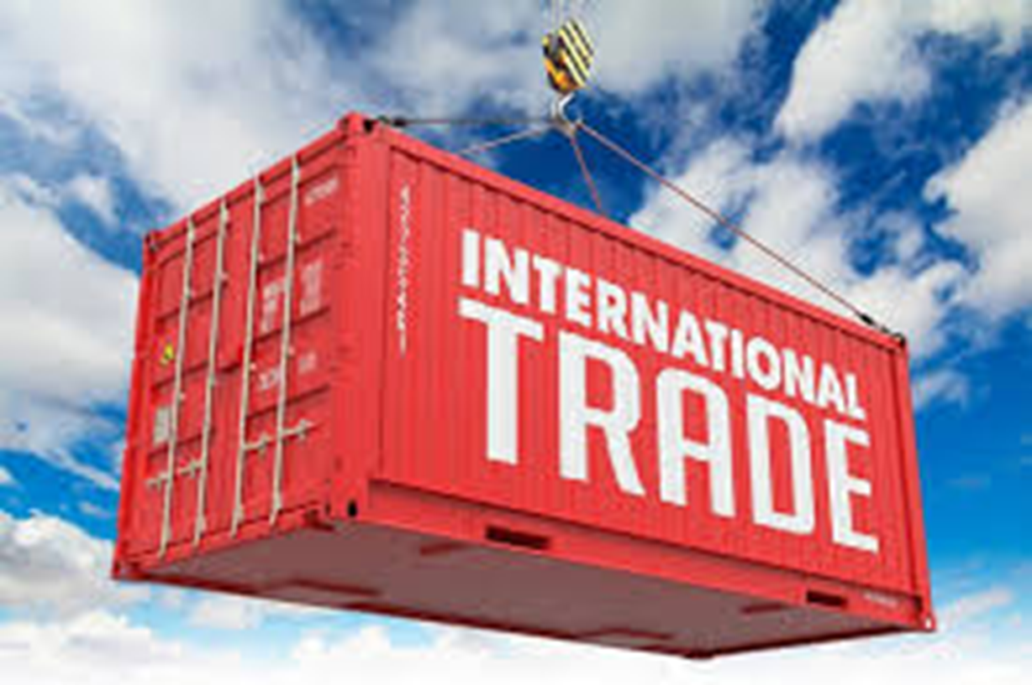
Dr.Rachanaa Datey
(Founder Director)
Quest Edustation Trainings and Learning Solutions

Slide 2
What is International Trade?
International trade is an exchange involving a good or service conducted between at least two different countries.
The exchanges can be imports or exports.
An import refers to a good or service brought into the domestic country.
An export refers to a good or service sold to a foreign country.

Slide 3

Why Does International Trade Occur?
International trade occurs because one country enjoys a comparative advantage in the production of a certain good or service, specifically if the opportunity cost of producing that good or service is lower for that country than any other country.

Slide 4
Sources of Comparative Advantage
International differences in climate
Differences in factor endowments
Differences in technology

Slide 5
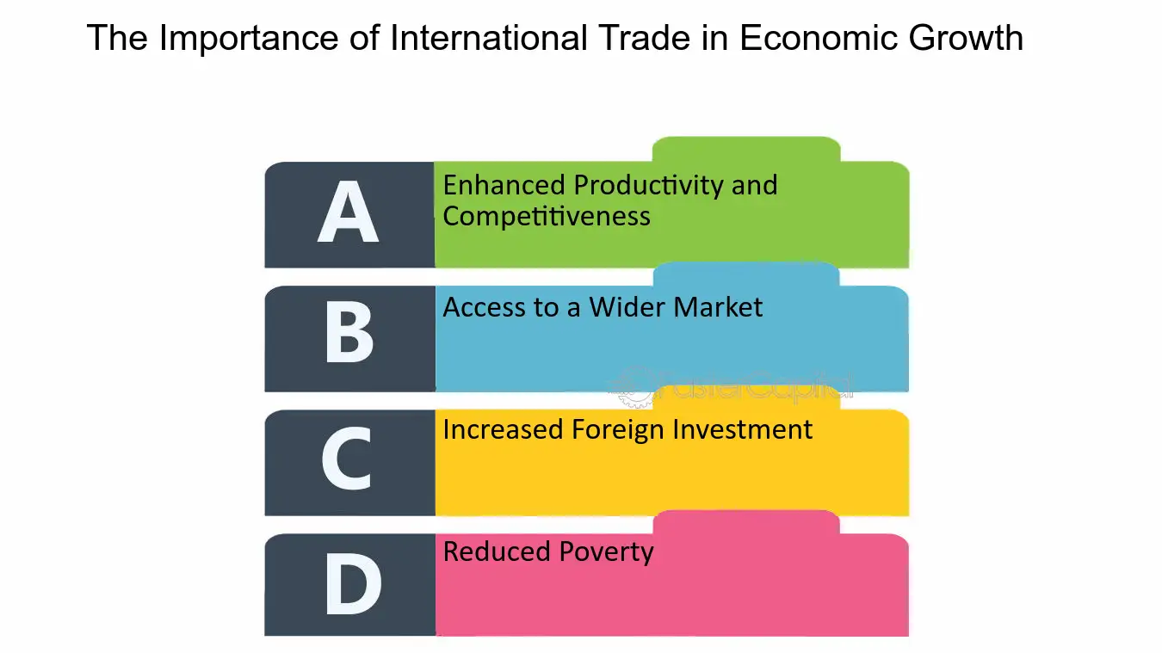

Slide 6
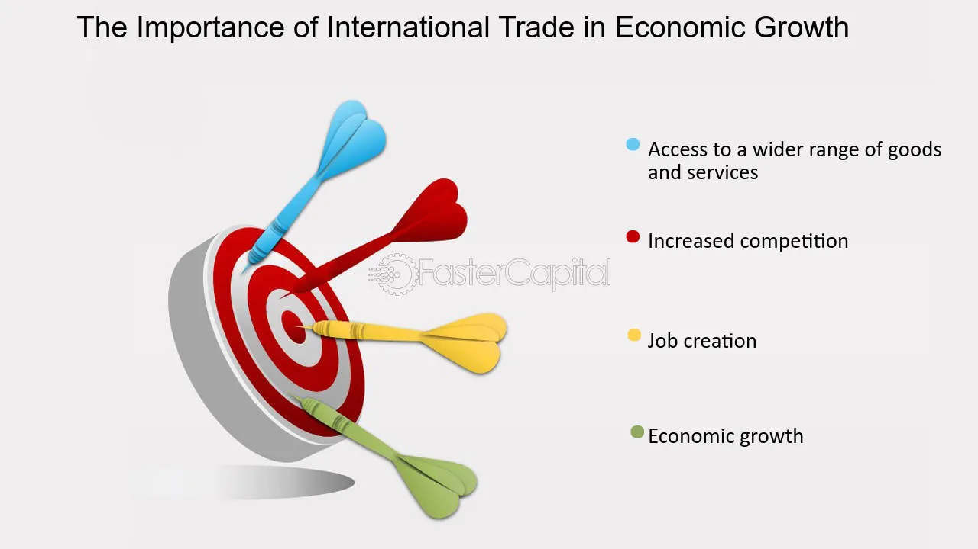
International trade plays a pivotal role in driving economic growth

Slide 7
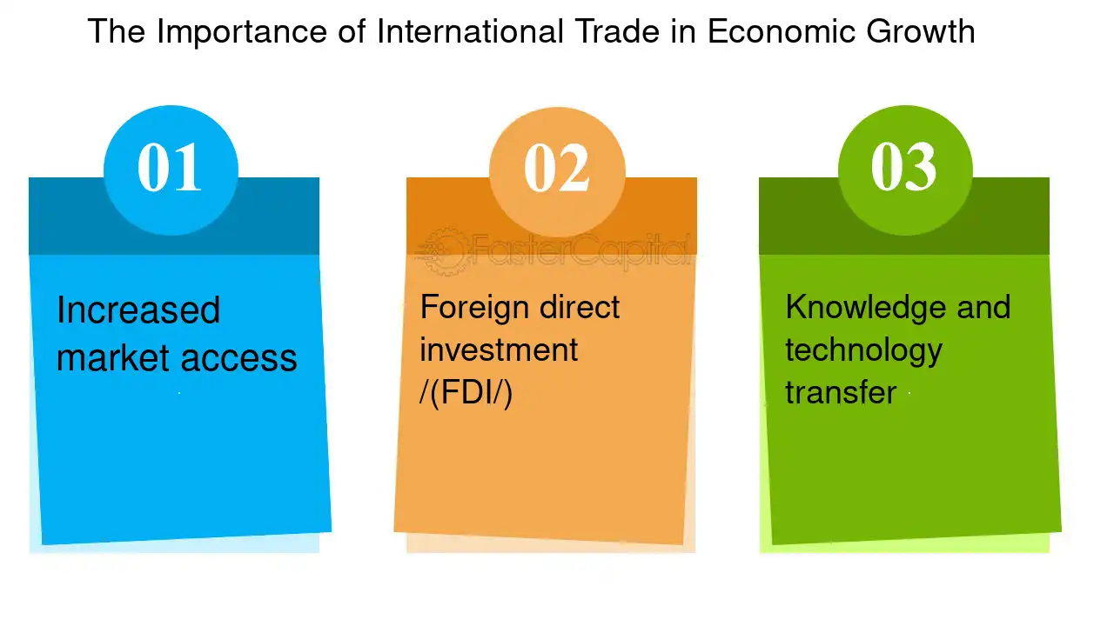
International trade promotes competition among nations.

Slide 8

The future of International trade and economic growth
Promoting
Promoting Free Trade
Investing
Investing in Innovation
Building
Building Stronger partnerships
Supporting
Supporting Small and Medium-sized Enterprises (SMEs)

Slide 9
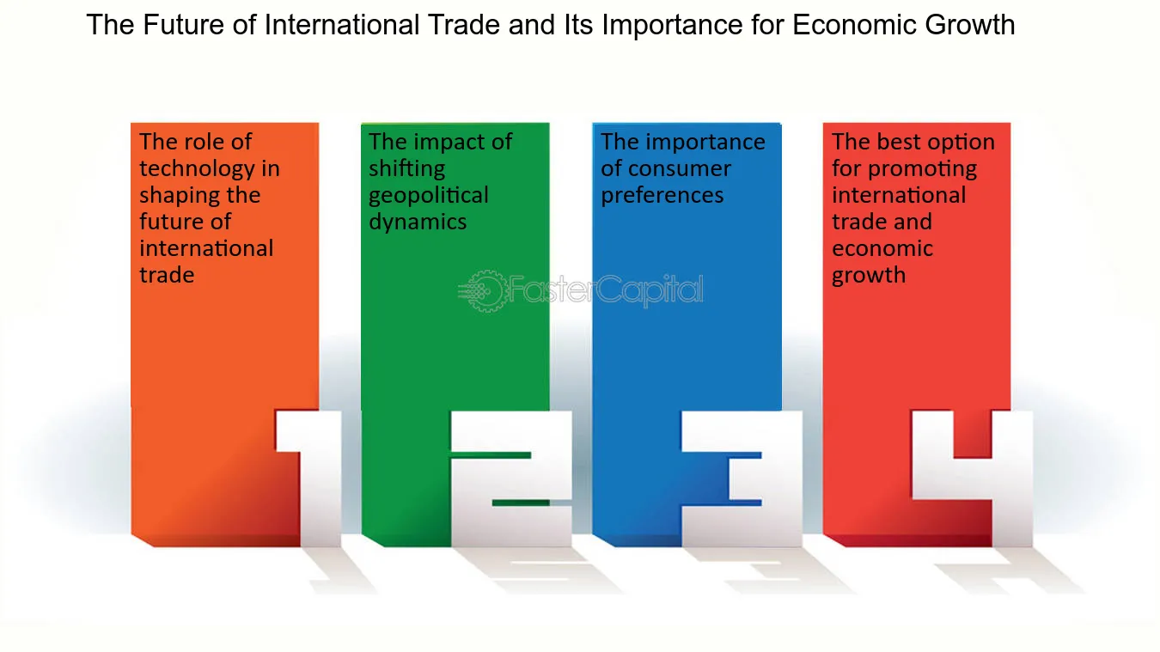

Slide 10
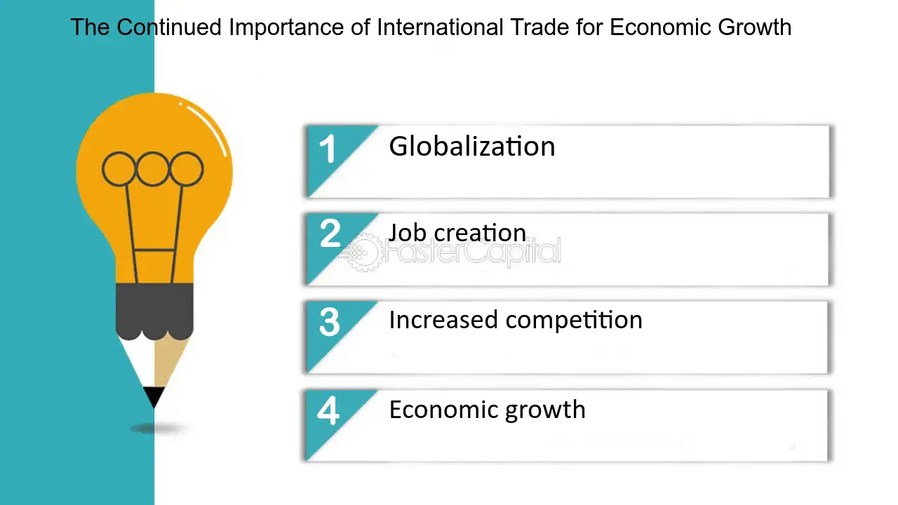

Slide 11
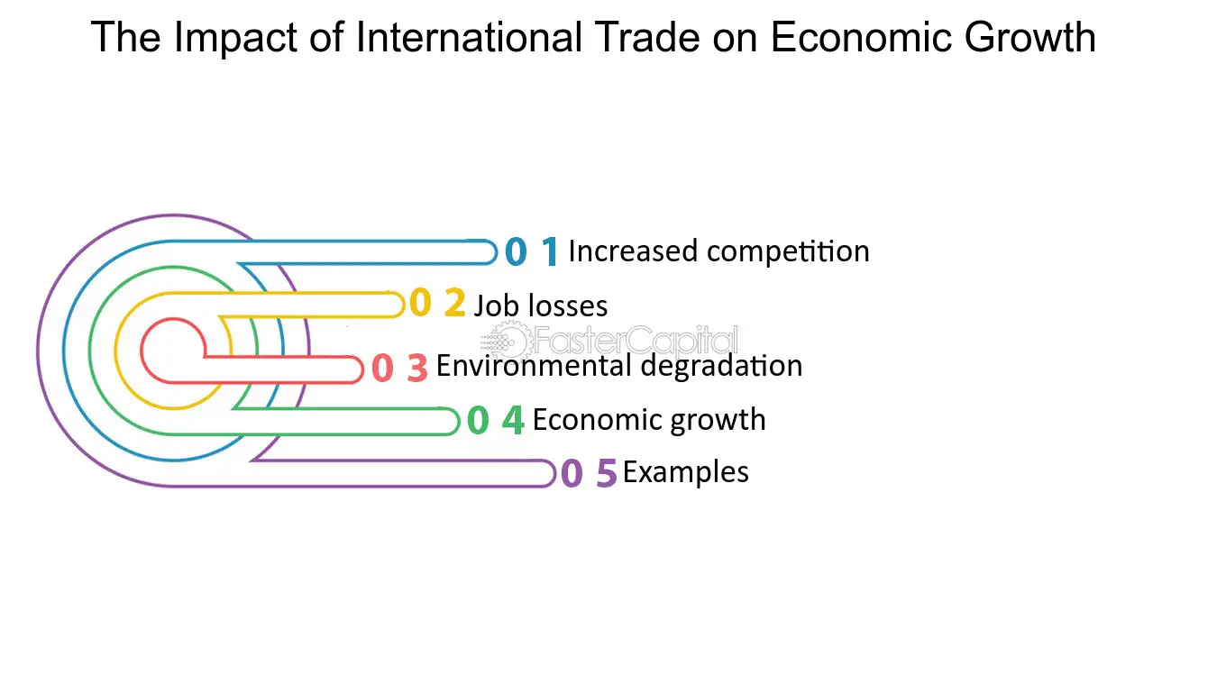

Slide 12
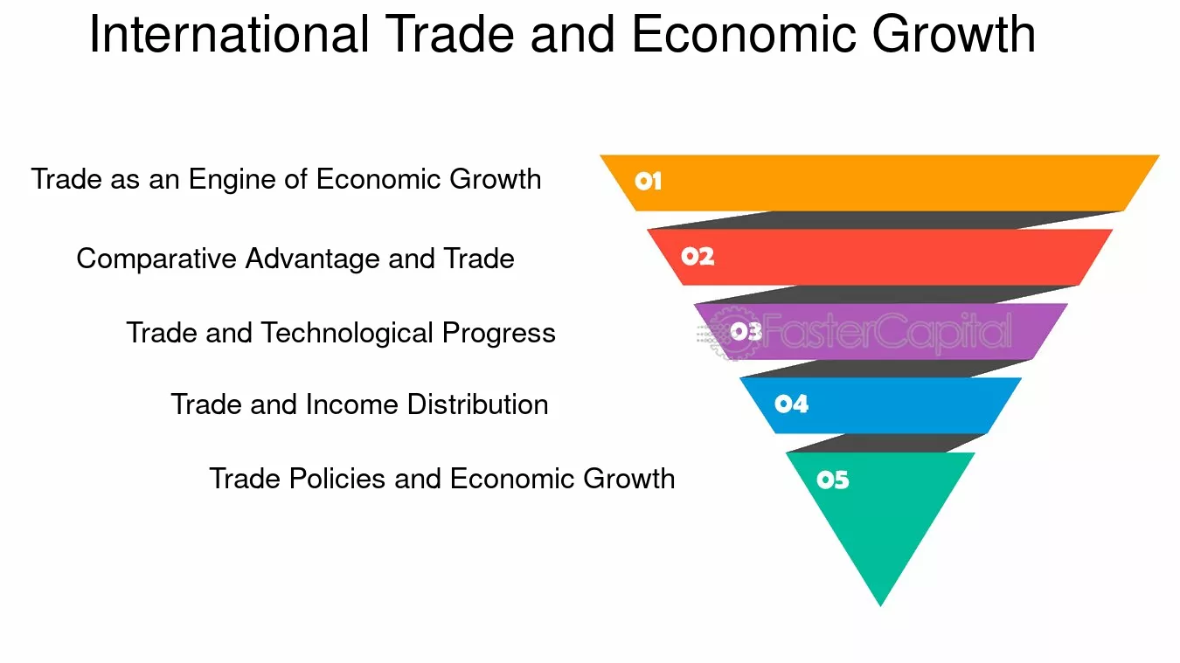

Slide 13
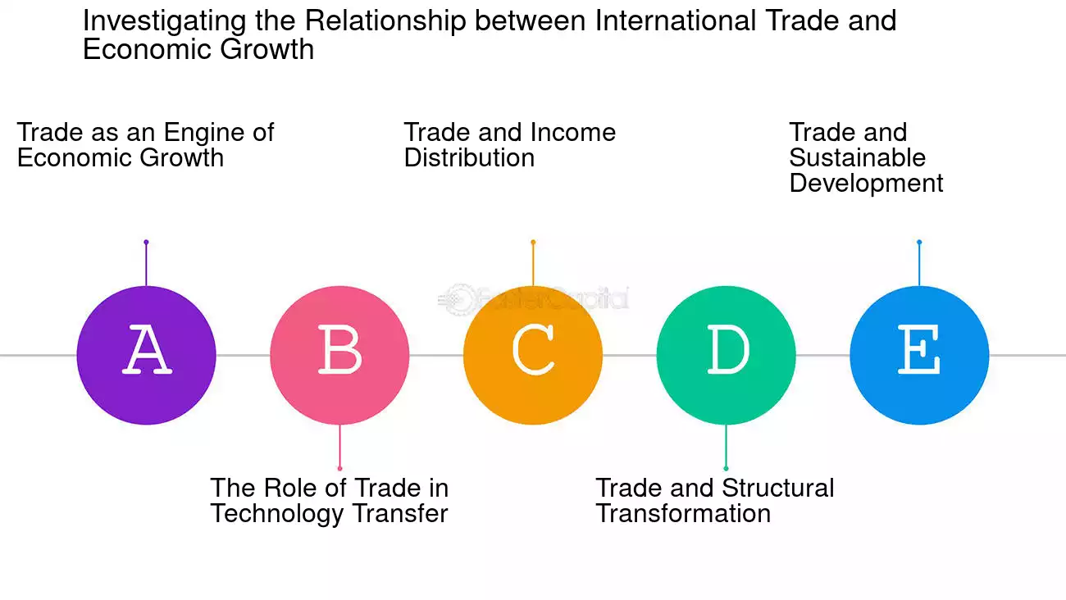

Slide 14
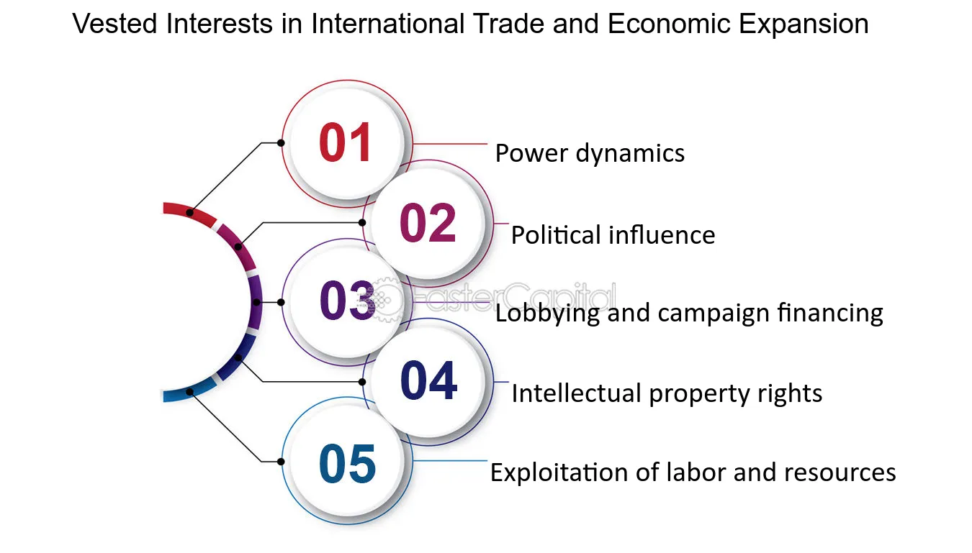

Slide 15
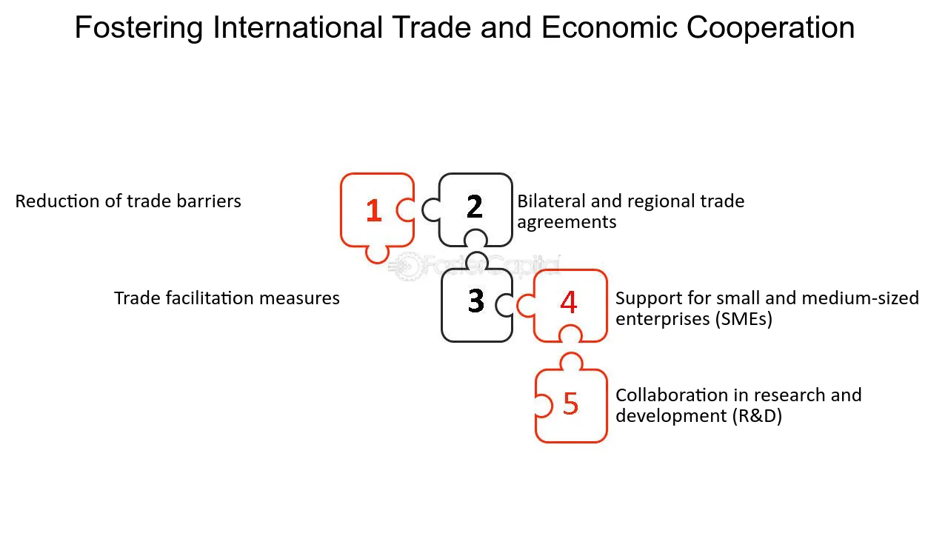

Slide 16
